Slide 1
Capstone Project
Smart Menu Solution – Research & Apply Formal Methods for Small Embedded System

Slide 2
What is Eclipse good for ?
Known as Integrated Development Environment
•Application / Tool Platform
•Open Architecture
•Designed for Extensibility
•Strong Modeling Infrastructure
•Open Source
•Reduced Costs
Eclipse

Slide 3
Research on Eclipse
•Eclipse Modeling Framework
•Graphical Editing/Modeling Framework
•Xpand - Generator Framework
•Xtext - DSL Toolkit
•UML2 support
•...

Slide 4
What is YAKINDU?
YAKINDU is a modular toolkit for model driven development of embedded systems
• built on Eclipse
• open source
• available at Eclipse Labs
Yakindu is:
http://eclipselabs.org/p/yakindu
http://yakindu.org

Slide 5
Model Driven Software Development (MDSD)
is a generic term for techniques,
that transform formal models
into executable software.

Slide 6
Model Driven Development (MDD)
Simplification by abstraction
• hide complexity
• focus on domain relevant aspects
• Generator encapsulates technical details
Transformation to target platform using generators (or interpreters)
• avoid redundancy (DRY: Don‘t Repeat Yourself)
• enforce architecture and design guidelines
• improve quality / reduce error rate / fix errors once
• improve productivity
• more flexibility for variants

Slide 7
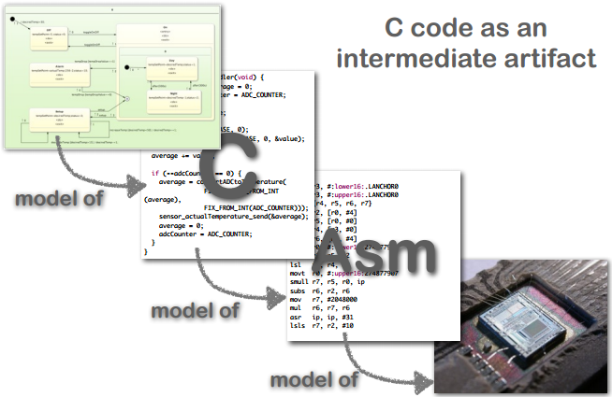
Model Driven Development (MDD)
Abstraction Levels:

Slide 8
When is MDD applicable?
• same solution for the same problem
• schematic technical implementation
• differences can be specified in the model
• less effort for specification than for implementation
• critical mass will be reached
• extent of models
• frequency of change
• number of target systems
• many variants

